Slide 1
Gaussian Process
Il-Chul Moon Dept. of Industrial and Systems Engineering KAIST
icmoon@kaist.ac.kr

Slide 2
Simple Continuous Domain Analysis

Slide 3
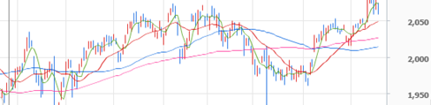
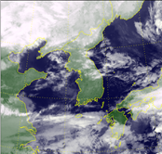
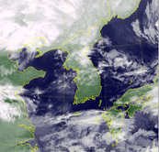
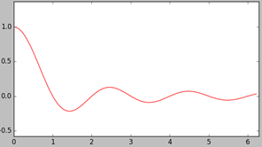
Continuous Domain Data
Real-world, many continuous domain
Time, Space, Spatio-Temporal….
Discrete time vs. Continuous time
How to analyze such dataset?
Estimation on the underlying function (ex, Autoregression)
Prediction on the unexplored point (ex, Extrapolation with autoregression)

Slide 4
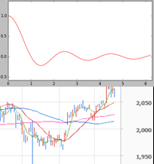
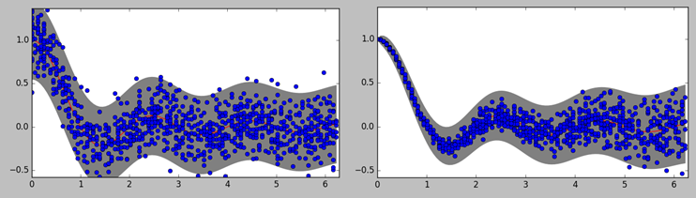
Underlying Function and Observations
Simple temporal line does not say much
Two cases of different observations from the same temporal line
An observation dataset can be explained with two temporal functions
Function in two continuous domain
Under the assumption that the observation’s noise is generated from a Gaussian distribution
Mean function
Variance function, or precision function
Previously, mean and variance was a value

Slide 5
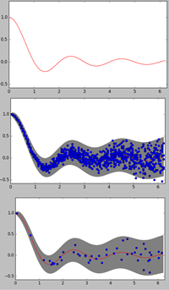
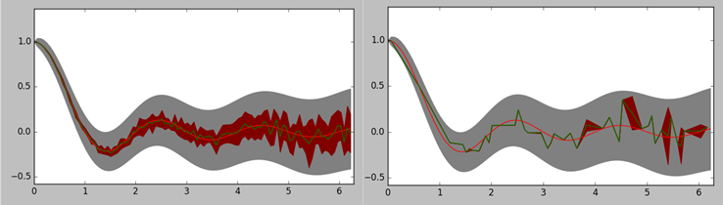
Simple Analyses without Domain Correlation
Estimating the mean function without the domain correlation
Calculating the mean and the precision of Y with the same X
Very unlikely in the real world
Continuous domain → No multiple observations with the same X
No utilization of the domain information
Yesterday’s observations might have some information on today’s latent function

Slide 6
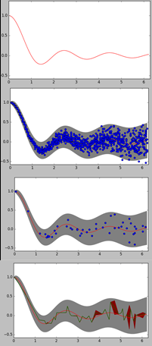
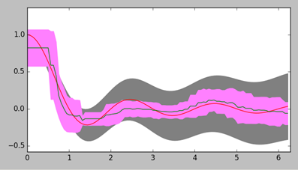
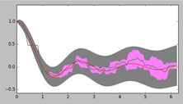
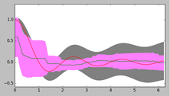
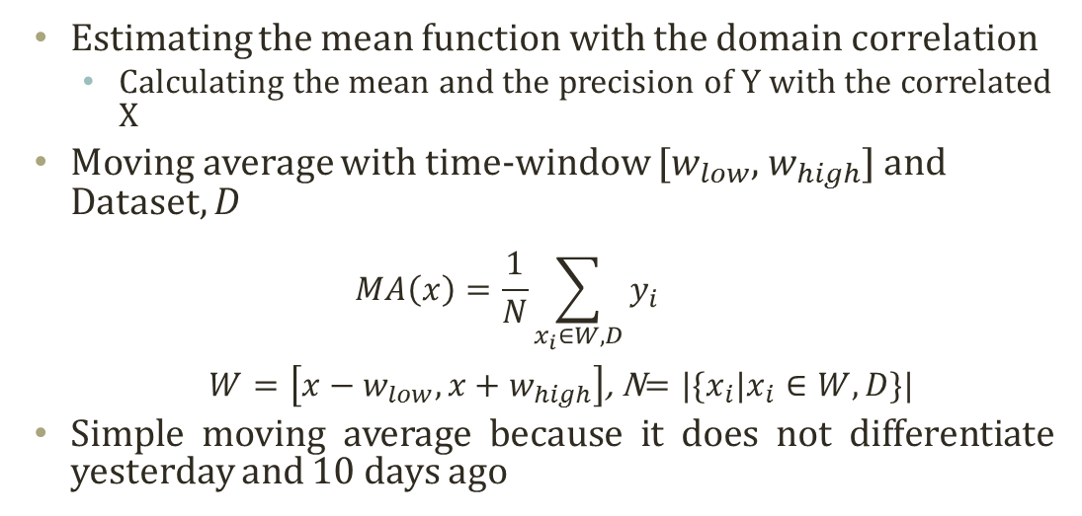
Simple Analyses with Domain Correlation
Estimating the mean function with the domain correlation
Calculating the mean and the precision of Y with the correlated X
Moving average with time-window [$w_{low}$, $w_{high}$] and Dataset, $D$
$$MA\left(x\right)=\frac{1}{N}\sum_{x_{i}∈W, D}{y_{i}}$$ $W=\left[x−w_{low},x+w_{high}\right]$, N$=|\{x_{i}|x_{i}∈W, D\}|$
Simple moving average because it does not differentiate yesterday and 10 days ago

Slide 7
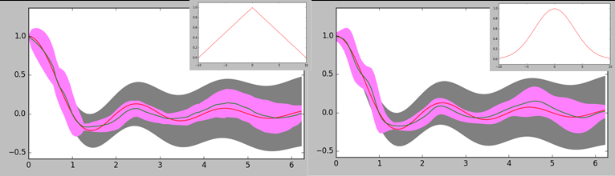
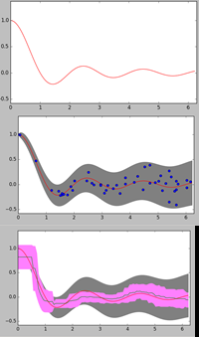

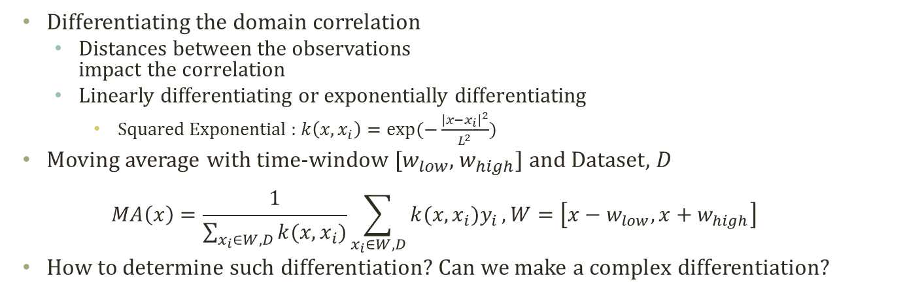

Simple Analyses with Differentiated Domain Correlation
Sample #=50
Differentiating the domain correlation
Distances between the observations impact the correlation
Linearly differentiating or exponentially differentiating
Squared Exponential : $k\left(x,x_{i}\right)=exp⁡(−\frac{{\left|x−x_{i}\right|}^{2}}{L^{2}})$
Moving average with time-window [$w_{low}$, $w_{high}$] and Dataset, $D$
$$MA\left(x\right)=\frac{1}{\sum_{x_{i}∈W, D}{k(x,x_{i})}}\sum_{x_{i}∈W, D}{k(x,x_{i})y_{i}}, W=\left[x−w_{low},x+w_{high}\right]$$
How to determine such differentiation? Can we make a complex differentiation?
Moving Avg with Time window [-$\frac{2π}{100}×$10,$\frac{2π}{100}×$10]

Slide 8
Derivation of Gaussian Process

Slide 9


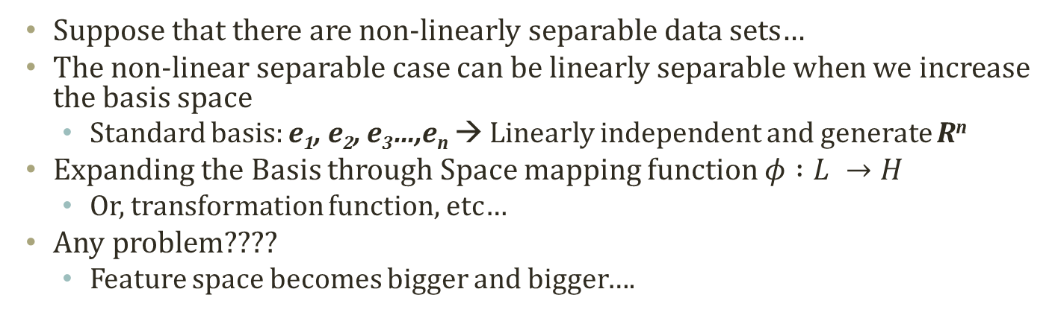





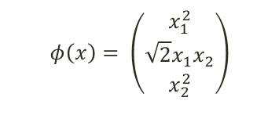




Detour: Mapping Functions
Suppose that there are non-linearly separable data sets…
The non-linear separable case can be linearly separable when we increase the basis space
Standard basis: e₁, e₂, e₃…,e_{n} → Linearly independent and generate R^{n}
Expanding the Basis through Space mapping function $φ :L →H$
Or, transformation function, etc…
Any problem????
Feature space becomes bigger and bigger….
$$x_{2}$$
$$x_{2}^{2}$$
$$φ\left(x\right)= \left(\begin{matrix}x_{1}^{2} \\ \sqrt{2}x_{1}x_{2} \\ x_{2}^{2}\end{matrix}\right)$$
(1,1)
$$\hat{c}=(0,0,1)^{T}$$
(0,1)
c
d
$$\hat{b}=(1,0,0)^{T}$$
(1,0)
(0,0)
$$\hat{a}=(0,0,0)^{T}$$
$$x_{1}^{2}$$
a
b
$$x_{1}$$
$$\hat{d}=(1,\sqrt{2},1)^{T}$$
$$\left(a\right) Original space, L$$
$$\sqrt{2}x_{1}x_{2}$$
$$\left(b\right) Mapping space, H$$

Slide 10
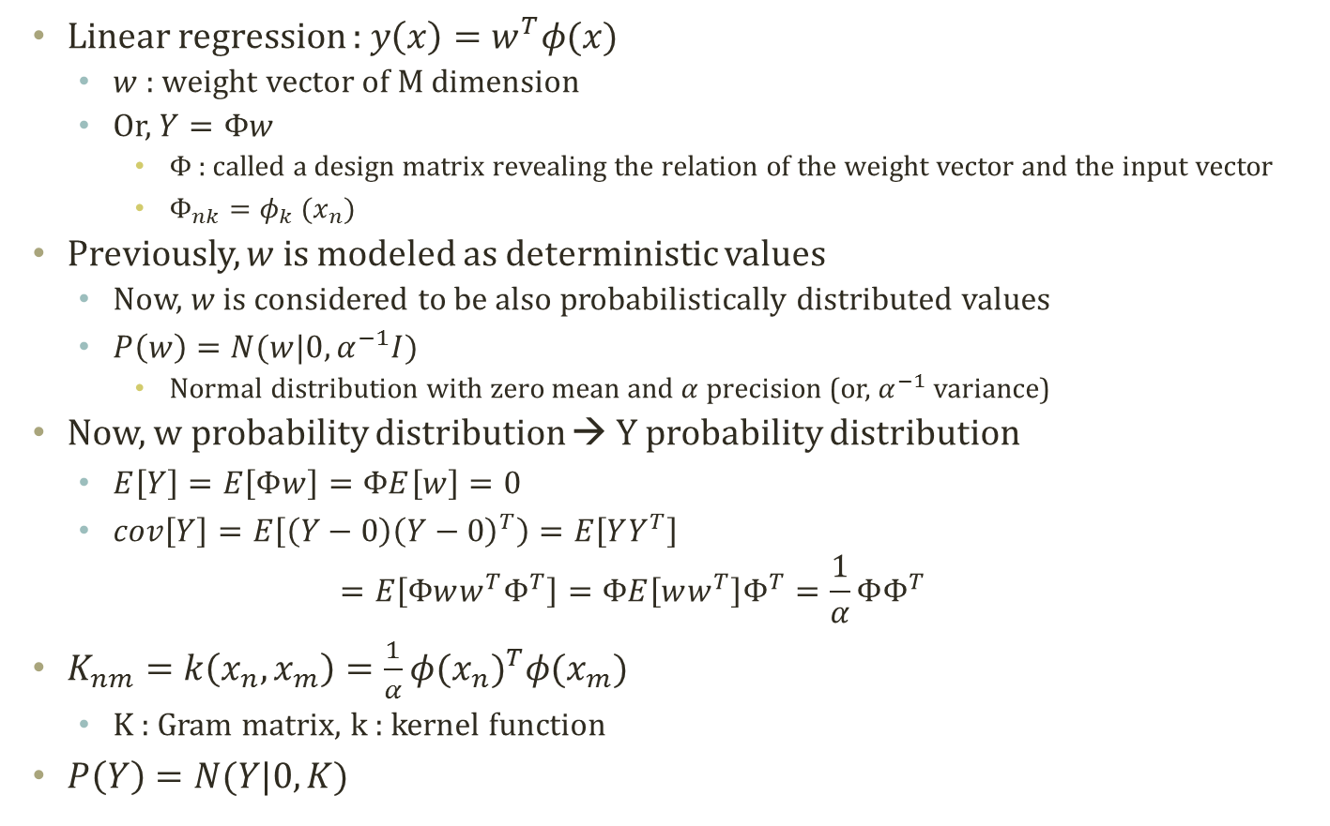
Linear Regression with Basis Function
Linear regression : $y\left(x\right)=w^{T}φ(x)$
$w$ : weight vector of M dimension
Or, $Y=Φw$
$Φ$ : called a design matrix revealing the relation of the weight vector and the input vector
$Φ_{nk}=φ_{k} (x_{n})$
Previously, $w$ is modeled as deterministic values
Now, $w$ is considered to be also probabilistically distributed values
$P\left(w\right)=N(w|0,α^{−1}I)$
Normal distribution with zero mean and $α$ precision (or, $α^{−1}$ variance)
Now, w probability distribution → Y probability distribution
$E\left[Y\right]=E\left[Φw\right]=ΦE\left[w\right]=0$
$cov\left[Y\right]=E\left[\left(Y−0\right){\left(Y−0\right)}^{T}\right)=E\left[YY^{T}\right]$ $=E\left[Φww^{T}Φ^{T}\right]=ΦE\left[ww^{T}\right]Φ^{T}=\frac{1}{α}ΦΦ^{T}$
$K_{nm}=k\left(x_{n},x_{m}\right)=\frac{1}{α}{φ(x_{n})}^{T}φ(x_{m})$
K : Gram matrix, k : kernel function
$P\left(Y\right)=N(Y|0,K)$

Slide 11
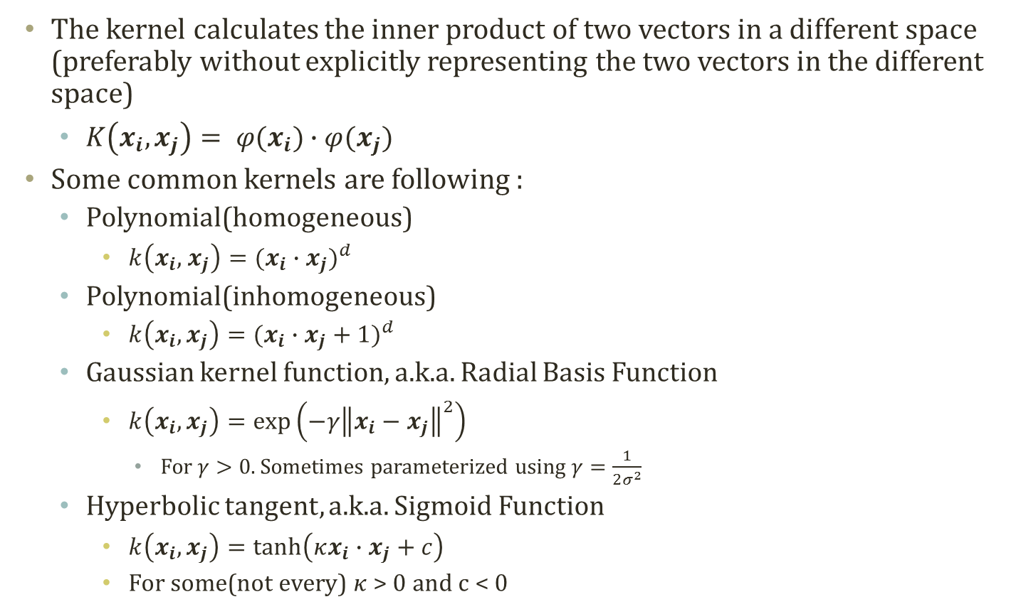
Detour: Kernel Function
The kernel calculates the inner product of two vectors in a different space (preferably without explicitly representing the two vectors in the different space)
$K\left(x_{i}, x_{j}\right)= φ(x_{i})∙φ(x_{j})$
Some common kernels are following :
Polynomial(homogeneous)
$k\left(x_{i}, { x}_{j}\right)=(x_{i}∙x_{j})^{d}$
Polynomial(inhomogeneous)
$k\left(x_{i}, x_{j}\right)=(x_{i}∙x_{j}+1)^{d}$
Gaussian kernel function, a.k.a. Radial Basis Function
$k\left(x_{i}, x_{j}\right)=\exp\left(−γ{\left\|x_{i}−x_{j}\right\|}^{2}\right)$
For $γ>0$. Sometimes parameterized using $γ=\frac{1}{2σ^{2}}$
Hyperbolic tangent, a.k.a. Sigmoid Function
$k\left(x_{i}, x_{j}\right)=\tanh\left(κx_{i}∙x_{j}+c\right)$
For some(not every) $κ$ > 0 and c < 0

Slide 12
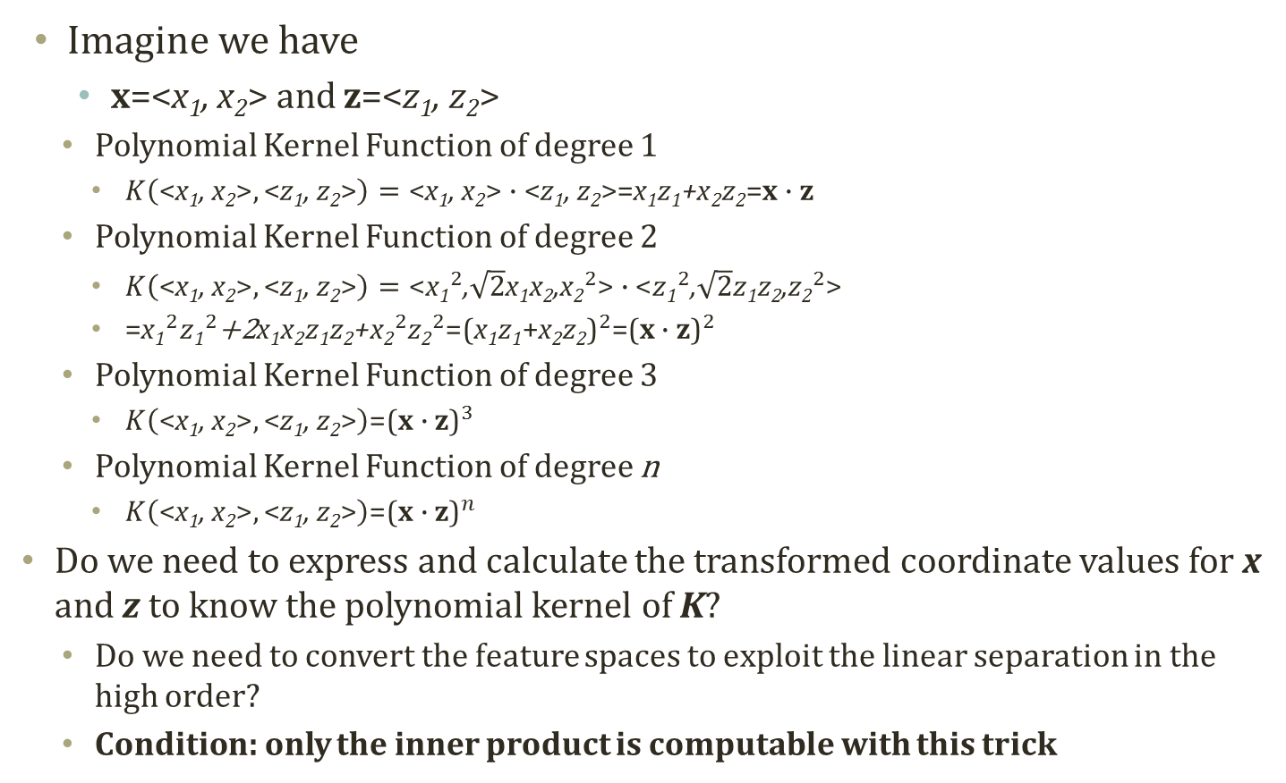
Detour: Polynomial Kernel Function
Imagine we have
x=<x₁, x₂> and z=<z₁, z₂>
Polynomial Kernel Function of degree 1
$K\left(\text{<}\text{x}\text{1}\text{, }\text{x}\text{2}\text{>},\text{<}\text{z}\text{1}\text{, }\text{z}\text{2}\text{>}\right)=\text{<}\text{x}\text{1}\text{, }\text{x}\text{2}\text{>}∙\text{<}\text{z}\text{1}\text{, }\text{z}\text{2}\text{>}\text{=}\text{x}\text{1}\text{z}\text{1}\text{+}\text{x}\text{2}\text{z}\text{2}\text{=}\text{x}∙\text{z}$
Polynomial Kernel Function of degree 2
$K\left(\text{<}\text{x}\text{1}\text{, }\text{x}\text{2}\text{>},\text{<}\text{z}\text{1}\text{, }\text{z}\text{2}\text{>}\right)=\text{<}{\text{x}\text{1}}^{2}\text{,}\sqrt{2}\text{x}\text{1}\text{x}\text{2}\text{,}{\text{x}\text{2}}^{2}\text{>}∙\text{<}{z\text{1}}^{2}\text{,}\sqrt{2}z\text{1}\text{z}\text{2}\text{,}{\text{z}\text{2}}^{2}\text{>}$
$\text{=}{\text{x}\text{1}}^{2}{z\text{1}}^{2}\text{+2}\text{x}\text{1}\text{x}\text{2}z\text{1}\text{z}\text{2}\text{+}{\text{x}\text{2}}^{2}{\text{z}\text{2}}^{2}\text{=}{\text{(}\text{x}\text{1}\text{z}\text{1}\text{+}\text{x}\text{2}\text{z}\text{2}\text{)}}^{2}\text{=}{\text{(}\text{x}∙\text{z}\text{)}}^{2}$
Polynomial Kernel Function of degree 3
$K\left(\text{<}\text{x}\text{1}\text{, }\text{x}\text{2}\text{>},\text{<}\text{z}\text{1}\text{, }\text{z}\text{2}\text{>}\right)\text{=}{\text{(}\text{x}∙\text{z}\text{)}}^{3}$
Polynomial Kernel Function of degree n
$K\left(\text{<}\text{x}\text{1}\text{, }\text{x}\text{2}\text{>},\text{<}\text{z}\text{1}\text{, }\text{z}\text{2}\text{>}\right)\text{=}{\text{(}\text{x}∙\text{z}\text{)}}^{n}$
Do we need to express and calculate the transformed coordinate values for x and z to know the polynomial kernel of K?
Do we need to convert the feature spaces to exploit the linear separation in the high order?
Condition: only the inner product is computable with this trick

Slide 13
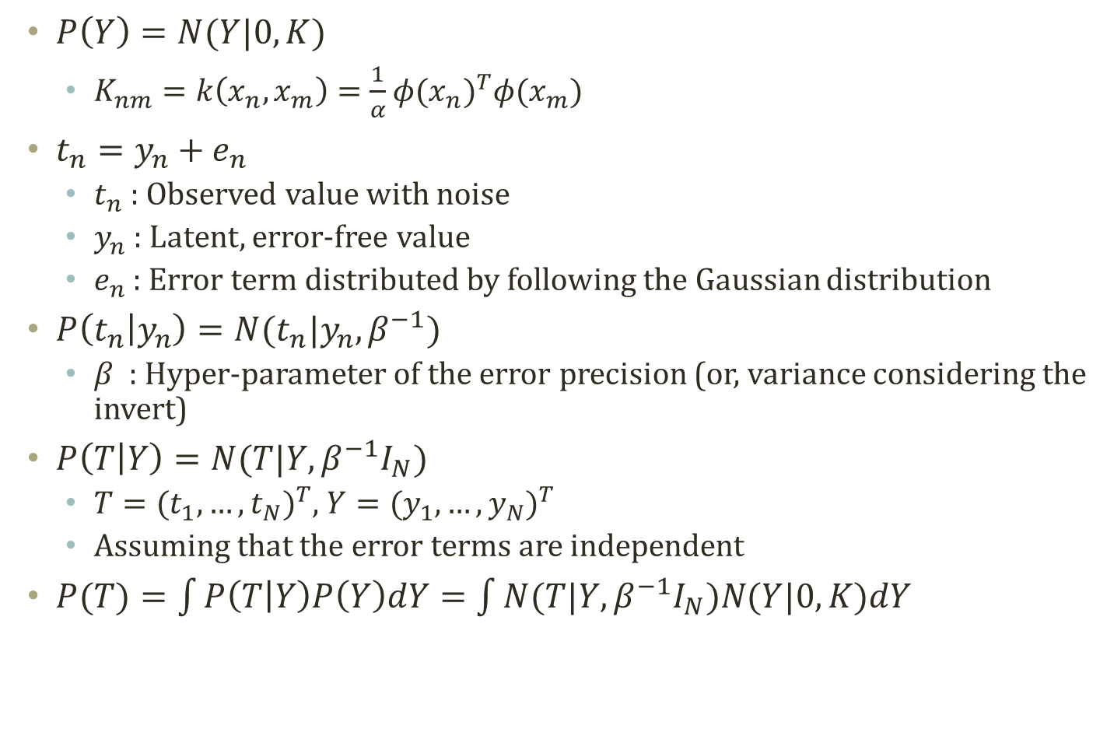
Modeling Noise with Gaussian Distribution
$P\left(Y\right)=N(Y|0,K)$
$K_{nm}=k\left(x_{n},x_{m}\right)=\frac{1}{α}{φ(x_{n})}^{T}φ(x_{m})$
$t_{n}=y_{n}+e_{n}$
$t_{n}$ : Observed value with noise
$y_{n}$ : Latent, error-free value
$e_{n}$ : Error term distributed by following the Gaussian distribution
$P\left(t_{n} | y_{n}\right)=N(t_{n}|y_{n}, β^{−1})$
$β$ : Hyper-parameter of the error precision (or, variance considering the invert)
$P\left(T | Y\right)=N(T|Y, β^{−1}I_{N})$
$T={(t_{1},…,t_{N})}^{T}$, $Y={(y_{1},…,y_{N})}^{T}$
Assuming that the error terms are independent
$P(T)=\int{P\left(T | Y\right)P\left(Y\right)dY}=\int{N(T|Y, β^{−1}I_{N})N(Y|0,K)dY}$

Slide 14

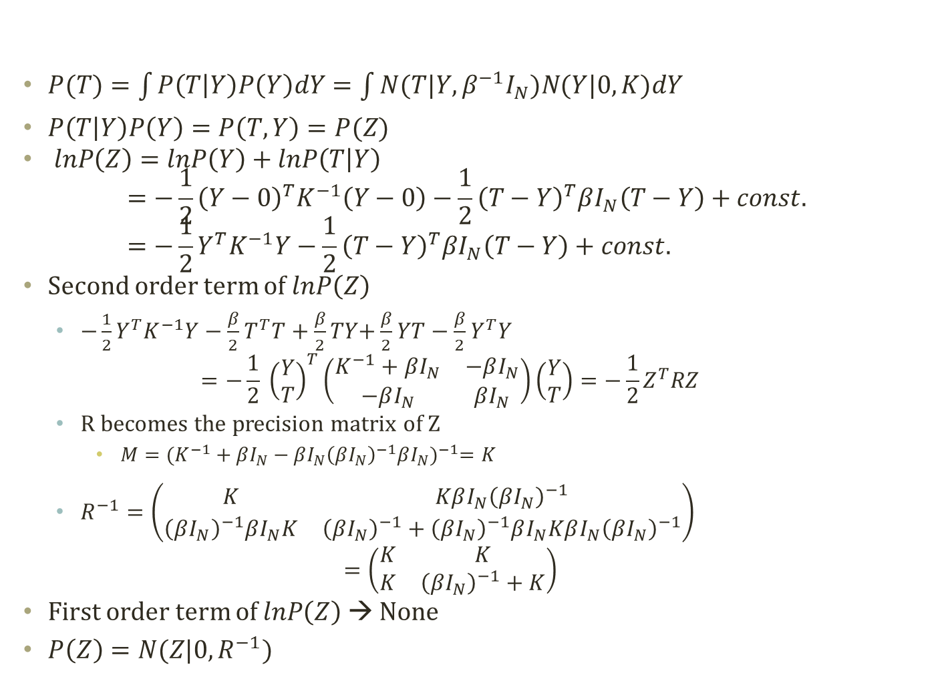

Marginal Gaussian Distribution
$P(T)=\int{P\left(T | Y\right)P\left(Y\right)dY}=\int{N(T|Y, β^{−1}I_{N})N(Y|0,K)dY}$
$P\left(T | Y\right)P\left(Y\right)=P\left(T,Y\right)=P(Z)$
$lnP\left(Z\right)=lnP\left(Y\right)+lnP\left(T | Y\right)$ $=−\frac{1}{2}{\left(Y−0\right)}^{T}K^{−1}\left(Y−0\right)−\frac{1}{2}{\left(T−Y\right)}^{T}βI_{N}\left(T−Y\right)+const.=−\frac{1}{2}Y^{T}K^{−1}Y−\frac{1}{2}{\left(T−Y\right)}^{T}βI_{N}\left(T−Y\right)+const.$
Second order term of $lnP\left(Z\right)$
$−\frac{1}{2}Y^{T}K^{−1}Y−\frac{β}{2}T^{T}T+\frac{β}{2}TY\text{+}\frac{β}{2}YT−\frac{β}{2}Y^{T}Y$ $=−\frac{1}{2} {\left(\begin{aligned}Y \\ T\end{aligned}\right)}^{T}\left(\begin{matrix}K^{−1}+βI_{N} & −βI_{N} \\ −βI_{N} & βI_{N}\end{matrix}\right)\left(\begin{aligned}Y \\ T\end{aligned}\right)=−\frac{1}{2}Z^{T}RZ$
R becomes the precision matrix of Z
$M={(K^{−1}+βI_{N}−βI_{N}{\left(βI_{N}\right)}^{−1}βI_{N})}^{−1}=K$
$R^{−1}=\left(\begin{matrix}K & KβI_{N}{\left(βI_{N}\right)}^{−1} \\ {\left(βI_{N}\right)}^{−1}βI_{N}K & {\left(βI_{N}\right)}^{−1}+{\left(βI_{N}\right)}^{−1}βI_{N}KβI_{N}{\left(βI_{N}\right)}^{−1}\end{matrix}\right)$ $=\left(\begin{matrix}K & K \\ K & {\left(βI_{N}\right)}^{−1}+K\end{matrix}\right)$
First order term of $lnP\left(Z\right)$ → None
$P\left(Z\right)=N(Z|0,R^{−1})$
$$N\left(x | μ,Σ\right)=\frac{1}{{(2π)}^{D/2}}\frac{1}{{|Σ|}^{1/2}}exp⁡(−\frac{1}{2}{\left(x−μ\right)}^{T}Σ^{−1}\left(x−μ\right))$$
$${\left(\begin{matrix}A & B \\ C & D\end{matrix}\right)}^{−1} \\ =\left(\begin{matrix}M & −MBD^{−1} \\ −D^{−1}CM & D^{−1}+D^{−1}CMBD^{−1}\end{matrix}\right) \\ M={(A−BD^{−1}\text{C}\text{)}}^{−1}$$

Slide 15
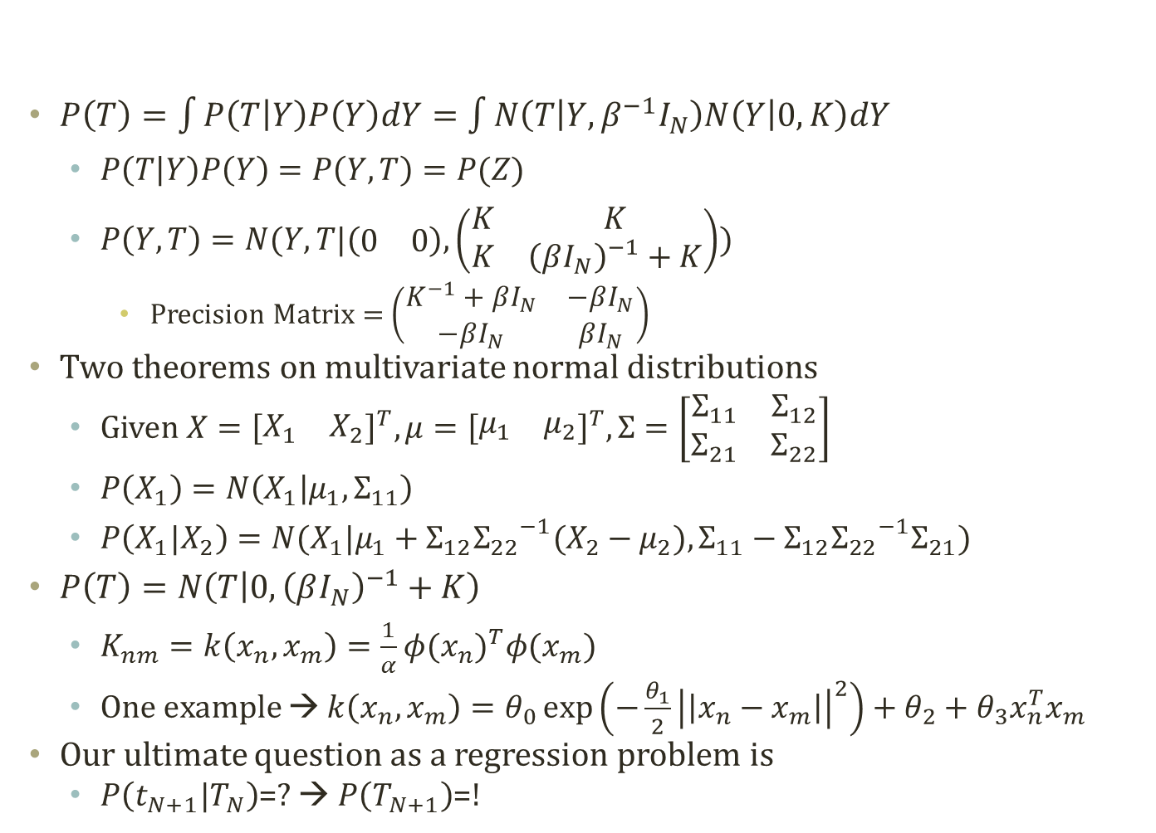
Marginal and Conditional Distribution of P(T)
$P\left(T\right)=\int{P\left(T | Y\right)P\left(Y\right)dY}=\int{N\left(T | Y, β^{−1}I_{N}\right)N\left(Y | 0,K\right)dY}$
$P\left(T | Y\right)P\left(Y\right)=P\left(Y,T\right)=P(Z)$
$P\left(Y,T\right)=N(Y,T|(\begin{matrix}0 & 0\end{matrix}),\left(\begin{matrix}K & K \\ K & {\left(βI_{N}\right)}^{−1}+K\end{matrix}\right))$
Precision Matrix = $\left(\begin{matrix}K^{−1}+βI_{N} & −βI_{N} \\ −βI_{N} & βI_{N}\end{matrix}\right)$
Two theorems on multivariate normal distributions
Given $X={\left[\begin{matrix}X_{1} & X_{2}\end{matrix}\right]}^{T},μ={\left[\begin{matrix}μ_{1} & μ_{2}\end{matrix}\right]}^{T},Σ=\left[\begin{matrix}Σ_{11} & Σ_{12} \\ Σ_{21} & Σ_{22}\end{matrix}\right]$
$P\left(X_{1}\right)=N\left(X_{1} | μ_{1},Σ_{11}\right)$
$P\left(X_{1}|X_{2}\right)=N(X_{1}|μ_{1}+Σ_{12}{Σ_{22}}^{−1}(X_{2}−μ_{2}),Σ_{11}−Σ_{12}{Σ_{22}}^{−1}Σ_{21})$
$P\left(T\right)=N\left(T | 0,{\left(βI_{N}\right)}^{−1}+K\right)$
$K_{nm}=k\left(x_{n},x_{m}\right)=\frac{1}{α}{φ(x_{n})}^{T}φ(x_{m})$
One example → $k\left(x_{n},x_{m}\right)=θ_{0}\exp\left(−\frac{θ_{1}}{2}{\left|\left|x_{n}−x_{m}\right|\right|}^{2}\right)+θ_{2}+θ_{3}x_{n}^{T}x_{m}$
Our ultimate question as a regression problem is
$P\left(t_{N+1}|T_{N}\right)$=? → $P\left(T_{N+1}\right)$=!

Slide 16

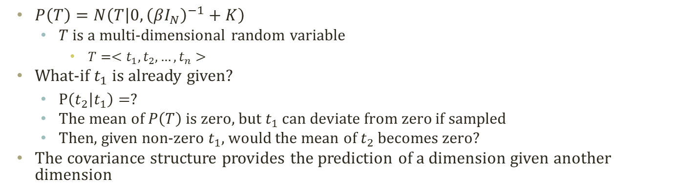



Prediction from Covariance
$P\left(T\right)=N\left(T | 0,{\left(βI_{N}\right)}^{−1}+K\right)$
$T$ is a multi-dimensional random variable
$T=<t_{1},t_{2},…,t_{n}>$
What-if $t_{1}$ is already given?
$P\left(t_{2} | t_{1}\right)=?$
The mean of $P\left(T\right)$ is zero, but $t_{1}$ can deviate from zero if sampled
Then, given non-zero $t_{1}$, would the mean of $t_{2}$ becomes zero?
The covariance structure provides the prediction of a dimension given another dimension
$$t_{2}$$
$$t_{2}$$
$$t_{1}$$
$$t_{1}$$

Slide 17
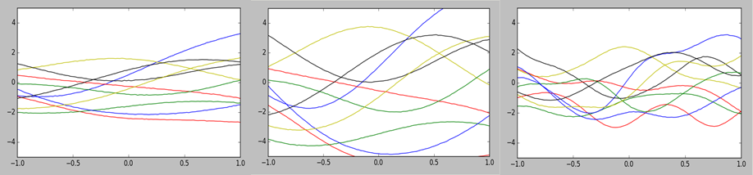
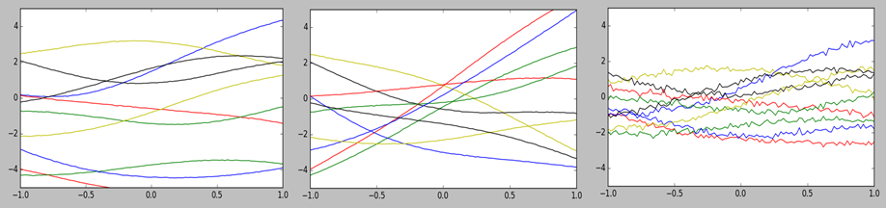
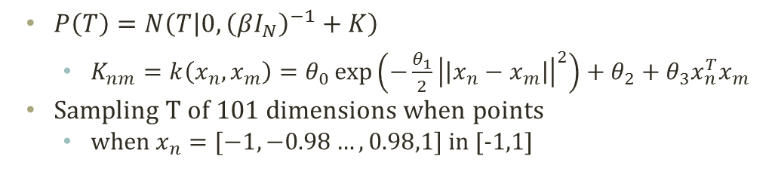
Sampling of P(T)
$P\left(T\right)=N\left(T | 0,{\left(βI_{N}\right)}^{−1}+K\right)$
$K_{nm}=k\left(x_{n},x_{m}\right)=θ_{0}\exp\left(−\frac{θ_{1}}{2}{\left|\left|x_{n}−x_{m}\right|\right|}^{2}\right)+θ_{2}+θ_{3}x_{n}^{T}x_{m}$
Sampling T of 101 dimensions when points
when $x_{n}=[−1,−0.98…,0.98,1]$ in [-1,1]
$$(θ_{0},θ_{1},θ_{2},θ_{3},β^{−1})=(1,1,1,1,0.0001)$$
$$(θ_{0},θ_{1},θ_{2},θ_{3},β^{−1})=(9,1,1,1,0.0001)$$
$$(θ_{0},θ_{1},θ_{2},θ_{3}, β^{−1})=(1,9,1,1,0.0001)$$
$$(θ_{0},θ_{1},θ_{2},θ_{3},β^{−1})=(1,1,9,1,0.0001)$$
$$(θ_{0},θ_{1},θ_{2},θ_{3},β^{−1})=(1,1,1,9,0.0001)$$
$$(θ_{0},θ_{1},θ_{2},θ_{3},β^{−1})=(1,1,1,1,0.01)$$

Slide 18
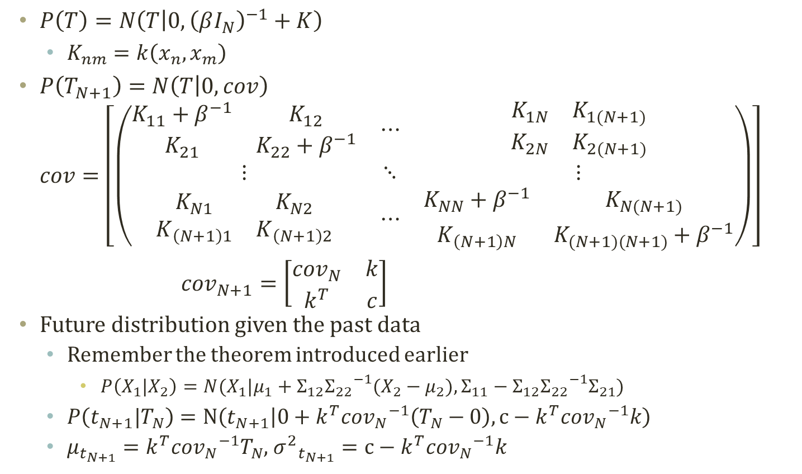

Mean and Covariance of $P\left(t_{N+1}|T_{N}\right)$
$P\left(T\right)=N\left(T | 0,{\left(βI_{N}\right)}^{−1}+K\right)$
$K_{nm}=k\left(x_{n},x_{m}\right)$
$P\left(T_{N+1}\right)=N\left(T | 0,cov\right)$
$$cov=\left[\left(\begin{matrix}\begin{matrix}K_{11}+β^{−1} & K_{12} \\ K_{21} & K_{22}+β^{−1}\end{matrix} & ⋯ & \begin{matrix}\begin{matrix}K_{1N} & K_{1(N+1)}\end{matrix} \\ \begin{matrix}K_{2N} & K_{2(N+1)}\end{matrix}\end{matrix} \\ ⋮ & ⋱ & ⋮ \\ \begin{matrix}K_{N1} & K_{N2} \\ K_{\left(N+1\right)1} & K_{\left(N+1\right)2}\end{matrix} & ⋯ & \begin{matrix}K_{NN}+β^{−1} & K_{N(N+1)} \\ K_{\left(N+1\right)N} & K_{(N+1)(N+1)}+β^{−1}\end{matrix}\end{matrix}\right)\right]$$
${cov}_{N+1}=\left[\begin{matrix}{cov}_{N} & k \\ k^{T} & c\end{matrix}\right]$
Future distribution given the past data
Remember the theorem introduced earlier
$P\left(X_{1}|X_{2}\right)=N(X_{1}|μ_{1}+Σ_{12}{Σ_{22}}^{−1}(X_{2}−μ_{2}),Σ_{11}−Σ_{12}{Σ_{22}}^{−1}Σ_{21})$
$P\left(t_{N+1}|T_{N}\right)=N\left(t_{N+1} | 0+k^{T}{{cov}_{N}}^{−1}\left(T_{N}−0\right),c−k^{T}{{cov}_{N}}^{−1}k\right)$
$μ_{t_{N+1}}=k^{T}{{cov}_{N}}^{−1}T_{N}$, ${σ^{2}}_{t_{N+1}}=c−k^{T}{{cov}_{N}}^{−1}k$

Slide 19
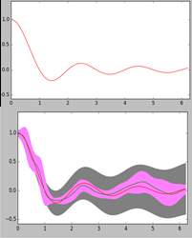
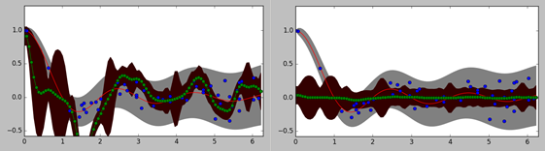
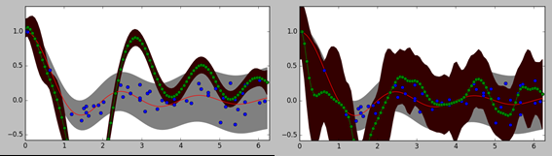
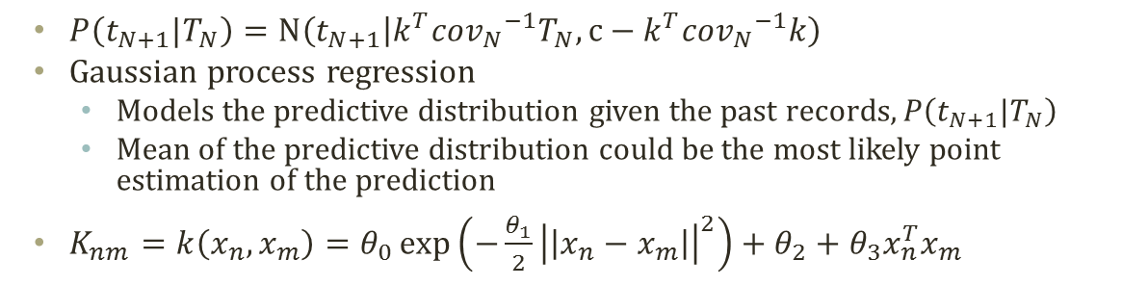
Gaussian Process Regression
$P\left(t_{N+1}|T_{N}\right)=N\left(t_{N+1} | k^{T}{{cov}_{N}}^{−1}T_{N},c−k^{T}{{cov}_{N}}^{−1}k\right)$
Gaussian process regression
Models the predictive distribution given the past records, $P\left(t_{N+1}|T_{N}\right)$
Mean of the predictive distribution could be the most likely point estimation of the prediction
$K_{nm}=k\left(x_{n},x_{m}\right)=θ_{0}\exp\left(−\frac{θ_{1}}{2}{\left|\left|x_{n}−x_{m}\right|\right|}^{2}\right)+θ_{2}+θ_{3}x_{n}^{T}x_{m}$
Squared Exponential with L=5
$$(θ_{0},θ_{1},θ_{2},θ_{3},β^{−1})=(0.5,50,0,0,0.01)$$
$$(θ_{0},θ_{1},θ_{2},θ_{3},β^{−1})=(0.1,50,0,0,0.01)$$
$$(θ_{0},θ_{1},θ_{2},θ_{3},β^{−1})=(0.5,10,0,0,0.01)$$
$$(θ_{0},θ_{1},θ_{2},θ_{3},β^{−1})=(0.5,50,0,0,0.1)$$

Slide 20
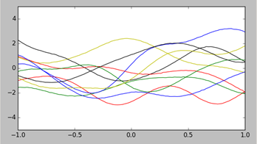
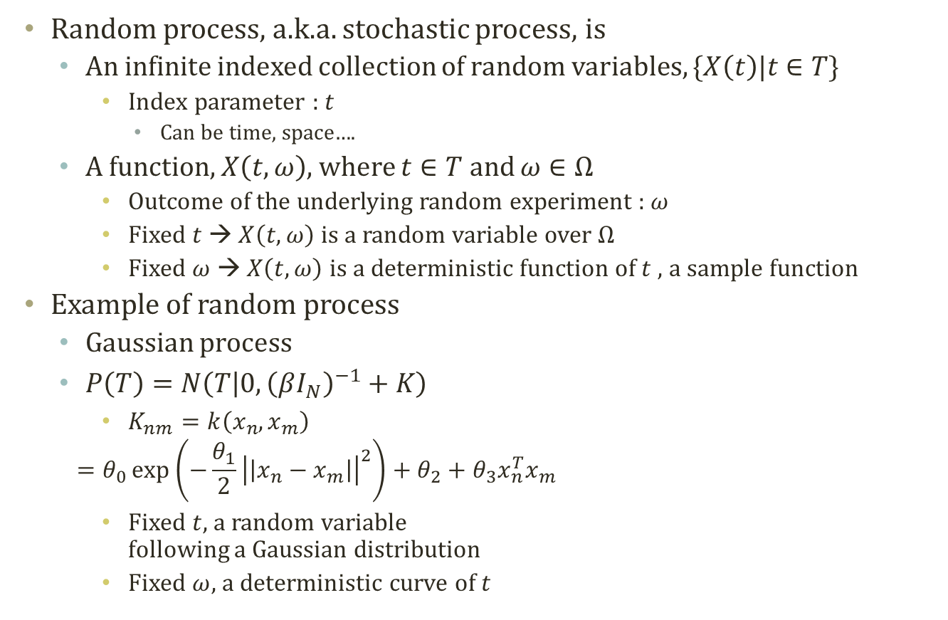
Random Process
Random process, a.k.a. stochastic process, is
An infinite indexed collection of random variables, $\{X\left(t\right)|t∈T\}$
Index parameter : $t$
Can be time, space….
A function, $X\left(t,ω\right)$, where $t∈T$ and $ω∈Ω$
Outcome of the underlying random experiment : $ω$
Fixed $t$ → $X\left(t,ω\right)$ is a random variable over $Ω$
Fixed $ω$ → $X\left(t,ω\right)$ is a deterministic function of $t$, a sample function
Example of random process
Gaussian process
$P\left(T\right)=N\left(T | 0,{\left(βI_{N}\right)}^{−1}+K\right)$
$K_{nm}=k\left(x_{n},x_{m}\right)$
$$=θ_{0}\exp\left(−\frac{θ_{1}}{2}{\left|\left|x_{n}−x_{m}\right|\right|}^{2}\right)+θ_{2}+θ_{3}x_{n}^{T}x_{m}$$
Fixed $t$, a random variable following a Gaussian distribution
Fixed $ω$, a deterministic curve of $t$

Slide 21

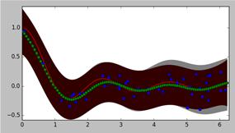

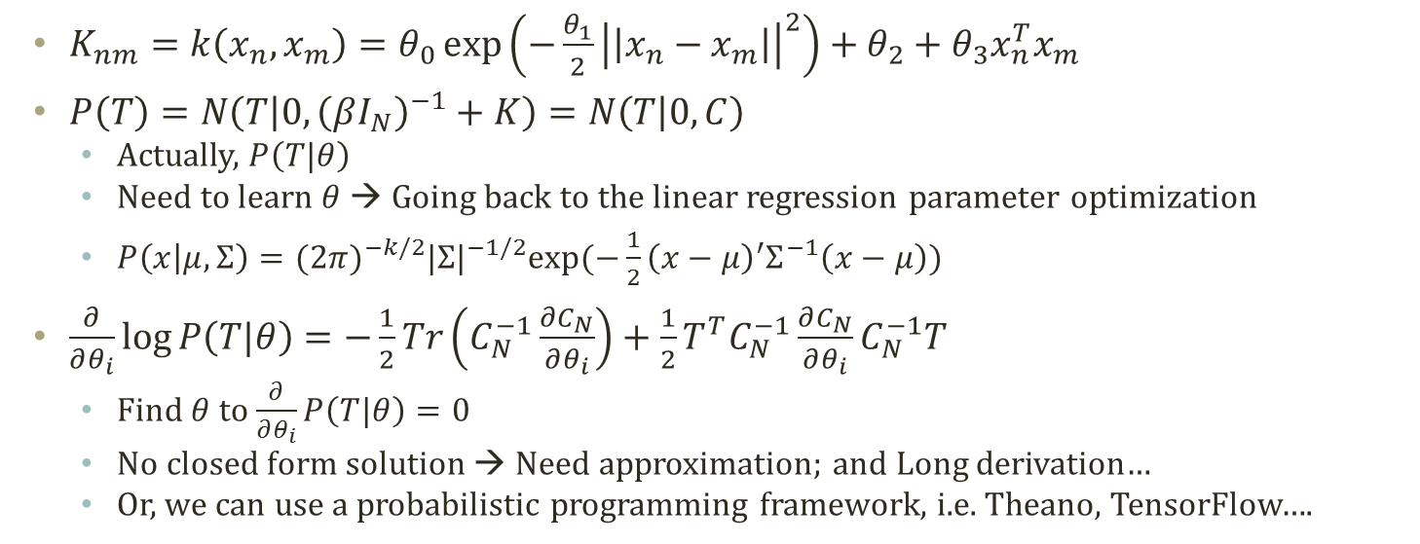


Hyper-parameters of Gaussian Process Regression
$K_{nm}=k\left(x_{n},x_{m}\right)=θ_{0}\exp\left(−\frac{θ_{1}}{2}{\left|\left|x_{n}−x_{m}\right|\right|}^{2}\right)+θ_{2}+θ_{3}x_{n}^{T}x_{m}$
$P\left(T\right)=N\left(T | 0,{\left(βI_{N}\right)}^{−1}+K\right)=N\left(T | 0,C\right)$
Actually, $P\left(T|θ\right)$
Need to learn $θ$ → Going back to the linear regression parameter optimization
$P\left(x | μ,Σ\right)={(2π)}^{−k/2}{|Σ|}^{−1/2}exp⁡(−\frac{1}{2}{\left(x−μ\right)}^{′}Σ^{−1}\left(x−μ\right))$
$\frac{∂}{∂θ_{i}}\log{P\left(T|θ\right)}=−\frac{1}{2}Tr\left(C_{N}^{−1}\frac{∂C_{N}}{∂θ_{i}}\right)+\frac{1}{2}T^{T}C_{N}^{−1}\frac{∂C_{N}}{∂θ_{i}}C_{N}^{−1}T$
Find $θ$ to $\frac{∂}{∂θ_{i}}P\left(T|θ\right)=0$
No closed form solution → Need approximation; and Long derivation…
Or, we can use a probabilistic programming framework, i.e. Theano, TensorFlow….
$$(θ_{0},θ_{1},θ_{2},θ_{3},β^{−1})=(0.5,10,0,0,0.01)$$
$$(θ_{0},θ_{1},θ_{2},θ_{3},β^{−1})=(0.5,50,0,0,0.1)$$
$$(θ_{0},θ_{1},θ_{2},θ_{3},β^{−1})=(1.377,1.122,1.384,1.858,9.980)$$

Slide 22
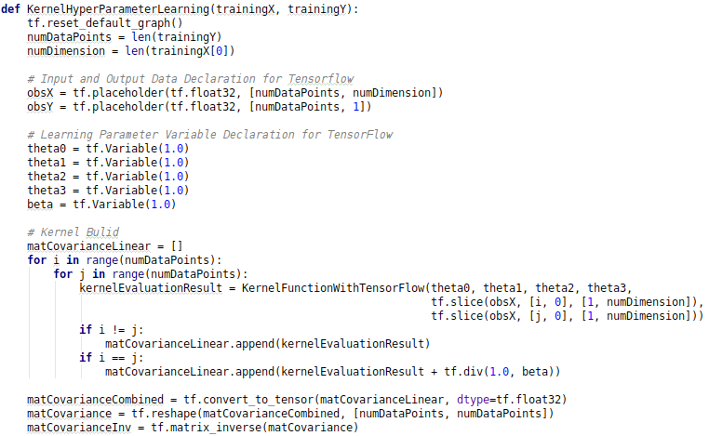
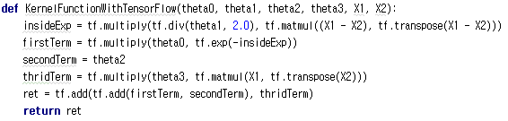
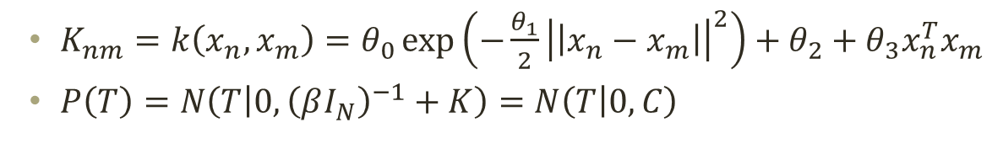
Probabilistic Programming for Hyperparameter Learning of GP (1)
$K_{nm}=k\left(x_{n},x_{m}\right)=θ_{0}\exp\left(−\frac{θ_{1}}{2}{\left|\left|x_{n}−x_{m}\right|\right|}^{2}\right)+θ_{2}+θ_{3}x_{n}^{T}x_{m}$
$P\left(T\right)=N\left(T | 0,{\left(βI_{N}\right)}^{−1}+K\right)=N\left(T | 0,C\right)$

Slide 23
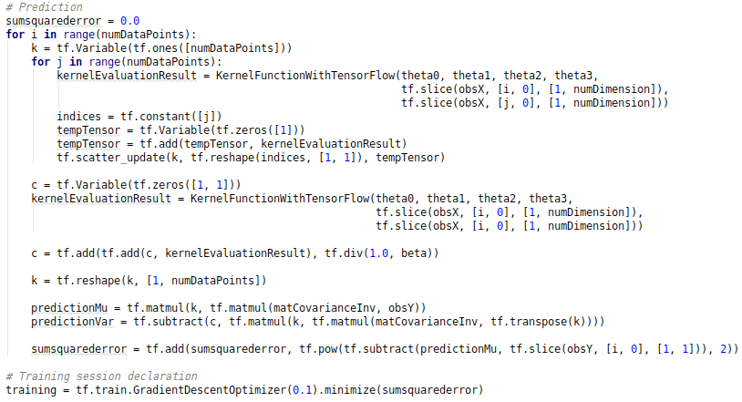
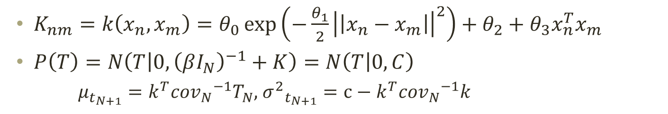
Probabilistic Programming for Hyperparameter Learning of GP (2)
$K_{nm}=k\left(x_{n},x_{m}\right)=θ_{0}\exp\left(−\frac{θ_{1}}{2}{\left|\left|x_{n}−x_{m}\right|\right|}^{2}\right)+θ_{2}+θ_{3}x_{n}^{T}x_{m}$
$P\left(T\right)=N\left(T | 0,{\left(βI_{N}\right)}^{−1}+K\right)=N\left(T | 0,C\right)$
$μ_{t_{N+1}}=k^{T}{{cov}_{N}}^{−1}T_{N}$, ${σ^{2}}_{t_{N+1}}=c−k^{T}{{cov}_{N}}^{−1}k$

Slide 24
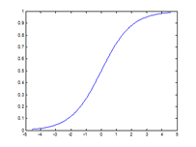

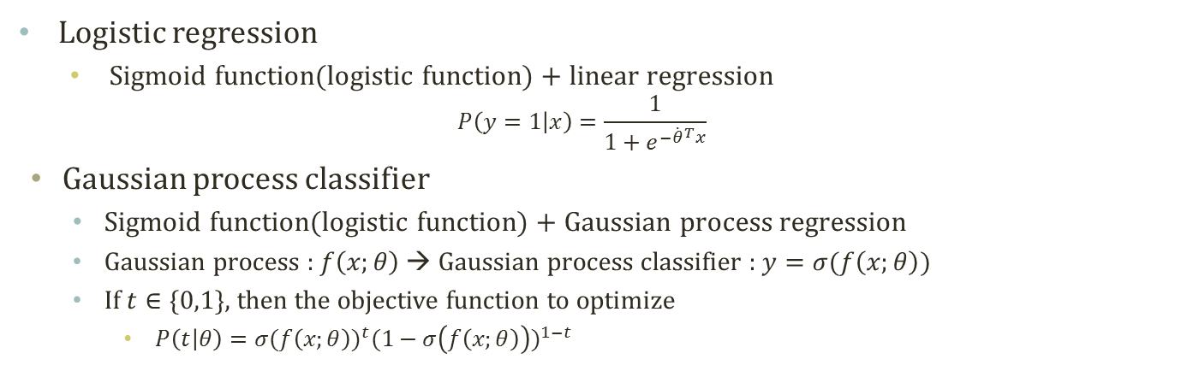

Gaussian Process Classifier
Sigmoid Function
P(Y=y|X)
P(Y=y|X)
1
Bayes Risk
$$R(f^{∗})$$
0
X
Classify as y
Classify as y
Logistic regression
Sigmoid function(logistic function) + linear regression
$$P\left(y=1 | x\right)=\frac{1}{1+e^{−{\dot{θ}}^{T}x}}$$
Gaussian process classifier
Sigmoid function(logistic function) + Gaussian process regression
Gaussian process : $f\left(x;θ\right)$ → Gaussian process classifier : $y=σ(f\left(x;θ\right))$
If $t∈\{0,1\}$, then the objective function to optimize
$P\left(t | θ\right)={σ(f\left(x;θ\right))}^{t}{(1−σ\left(f\left(x;θ\right)\right))}^{1−t}$

Slide 25
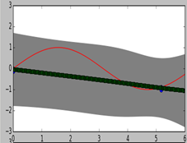
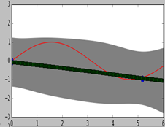
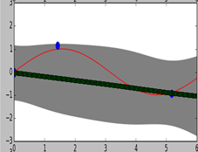
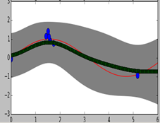
Bayesian Optimization with Gaussian Process
Imagine we have a sequence of experiments that we can set the input as we want
The experiment result should be maximized
We don’t know the underlying function generating the experiment results
The result and the input are continuous
The result have a stochastic element
Previous approaches include search methods
Grid search : no learning of underlying function
Fixed sampling inputs
Binary search : learning of constraints, not the function
Adaptively change sampling inputs
Integration of learning underlying function and selecting the next sampling input

Slide 26
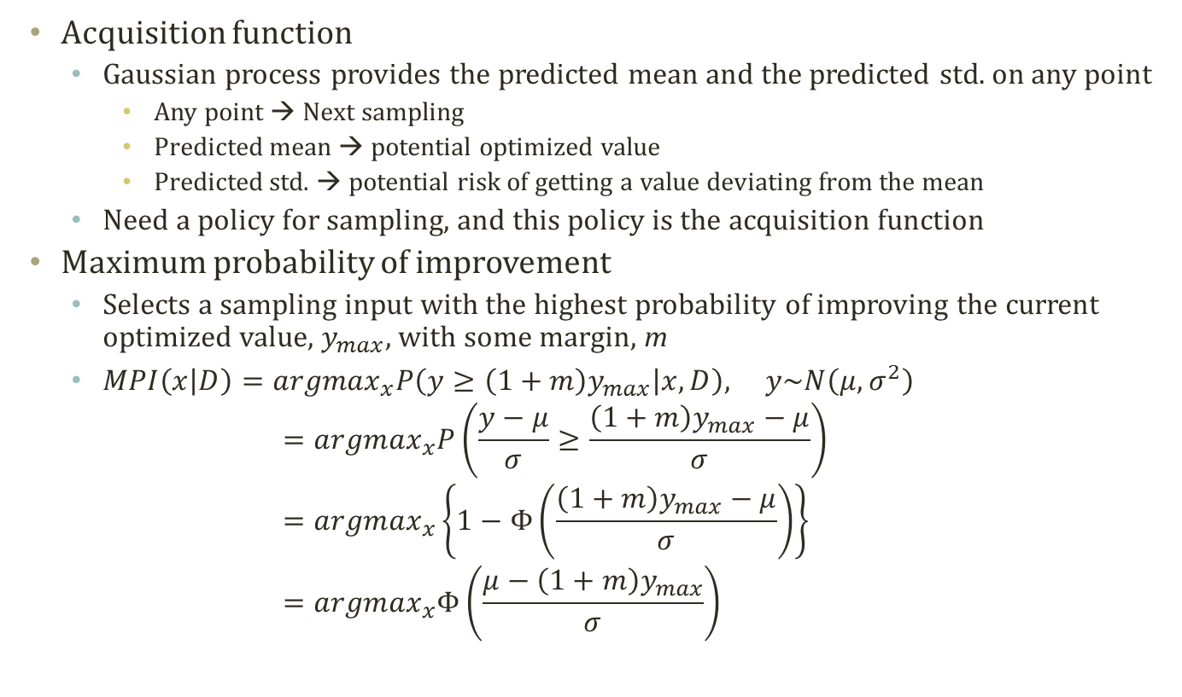
Acquisition Function: Maximum Probability of Improvement
Acquisition function
Gaussian process provides the predicted mean and the predicted std. on any point
Any point → Next sampling
Predicted mean → potential optimized value
Predicted std. → potential risk of getting a value deviating from the mean
Need a policy for sampling, and this policy is the acquisition function
Maximum probability of improvement
Selects a sampling input with the highest probability of improving the current optimized value, $y_{max},$ with some margin, m
$MPI\left(x | D\right)={argmax}_{x}P\left(y≥\left(1+m\right)y_{max} | x,D\right), y\sim N\left(μ,σ^{2}\right)$ $={argmax}_{x}P\left(\frac{y−μ}{σ}≥\frac{\left(1+m\right)y_{max}−μ}{σ}\right)$ $={argmax}_{x}\left\{1−Φ\left(\frac{\left(1+m\right)y_{max}−μ}{σ}\right)\right\}$ $={argmax}_{x}Φ\left(\frac{μ−\left(1+m\right)y_{max}}{σ}\right)$

Slide 27


Acquisition Function: Maximum Expected Improvement
Maximum expected improvement
A problem of maximum probability of improvement is
Introducing another hyperparameter, m
Why not take an expectation over the range of m which is from 0 to infinite
Assumption
$y=f\left(x\right),y_{max}=\max_{m=1,…,n}{f(x_{m})},u=\frac{y_{max}−μ}{σ}\text{,}v=\frac{y−μ}{σ}, μ=f(x|𝒟\text{),} σ\text{ = }K(x|𝒟)$
$MEI\left(x | D\right)={argmax}_{x}\int_{0}^{∞}{P(y≥y_{max}+m)}m dm$
$\int_{0}^{∞}{P(y≥y_{max}+m)}m dm=\int_{0}^{∞}{P\left(\frac{y−μ}{σ}≥\frac{y_{max}−μ+m}{σ}\right)mⅆm}=\int_{0}^{∞}{P\left(v≥u+\frac{m}{σ}\right)mⅆm}$
$=\int_{0}^{∞}{\int_{u+\frac{m}{σ}}^{∞}{φ\left(\tilde{v}\right)d\tilde{v}}mdm}=\int_{0}^{∞}{\int_{0}^{∞}{χ_{\left[u+\frac{m}{σ},∞\right)}(\tilde{v})φ\left(\tilde{v}\right)d\tilde{v}}mdm}=\int_{0}^{∞}{\int_{0}^{∞}{mχ_{\left[u+\frac{m}{σ},∞\right)}(\tilde{v})φ\left(\tilde{v}\right)dv}dm}=\int_{0}^{∞}{\int_{0}^{∞}{mχ_{\left[u+\frac{m}{σ},∞\right)}(\tilde{v})φ\left(\tilde{v}\right)dm}dv}=\int_{0}^{∞}{\left\{\int_{0}^{∞}{mχ_{\left[u+\frac{m}{σ},∞\right)}\left(\tilde{v}\right)dm}\right\}φ(\tilde{v})d\tilde{v}}=\int_{0}^{∞}{\left\{\int_{0}^{∞}{mχ_{\{0≤m≤σ\left(\tilde{v}−u\right)\}}\left(\tilde{v}\right)dm}\right\}φ(\tilde{v})d\tilde{v}}=\int_{0}^{∞}{\left\{\int_{0}^{∞}{mχ_{\left\{0≤m≤σ\left(\tilde{v}−u\right)\right\}∩\{0≤σ\left(\tilde{v}−u\right)\}}\left(\tilde{v}\right)dm}\right\}φ(\tilde{v})d\tilde{v}}=\int_{0}^{∞}{\left\{\int_{0}^{∞}{mχ_{\left\{0≤m≤σ\left(\tilde{v}−u\right)\right\}}\left(\tilde{v}\right)χ_{\left\{0≤σ\left(\tilde{v}−u\right)\right\}}(\tilde{v})dm}\right\}φ(\tilde{v})d\tilde{v}}=\int_{0}^{∞}{\left\{\int_{0}^{∞}{mχ_{\left\{0≤m≤σ\left(\tilde{v}−u\right)\right\}}\left(\tilde{v}\right)dm}\right\}χ_{\left\{0≤σ\left(\tilde{v}−u\right)\right\}}(\tilde{v})φ(\tilde{v})d\tilde{v}}=\int_{u}^{∞}{\left\{\int_{0}^{σ(\tilde{v}−u)}{mdm}\right\}φ(\tilde{v})d\tilde{v}}=\int_{u}^{∞}{\frac{1}{2}σ^{2}{\left(\tilde{v}−u\right)}^{2}φ(\tilde{v})d\tilde{v}}=\frac{1}{2}σ^{2}\left[\int_{u}^{∞}{{\tilde{v}}^{2}φ\left(\tilde{v}\right)d\tilde{v}}−2u\int_{u}^{∞}{\tilde{v}φ\left(\tilde{v}\right)d\tilde{v}}+u^{2}\int_{u}^{∞}{φ\left(\tilde{v}\right)d\tilde{v}}\right]=\frac{1}{2}σ^{2}\left[−uφ\left(u\right)+\left(1+u^{2}\right)Φ\left(−u\right)\right]$
$∵\int_{u}^{∞}{{\tilde{v}}^{2}φ\left(\tilde{v}\right)d\tilde{v}}=\int_{u}^{∞}{\frac{1}{\sqrt{2π}}{\tilde{v}}^{2}\exp\left(−\frac{{\tilde{v}}^{2}}{2}\right)d\tilde{v}}={\left[−\frac{1}{\sqrt{2π}}\tilde{v}\exp\left(−\frac{{\tilde{v}}^{2}}{2}\right)\right]}_{u}^{∞}+\int_{u}^{∞}{\frac{1}{√2π}}\exp\left(−\frac{{\tilde{v}}^{2}}{2}\right)d\tilde{v}={\left[−\frac{1}{\sqrt{2π}}\tilde{v}\exp\left(−\frac{{\tilde{v}}^{2}}{2}\right)\right]}_{u}^{∞}+\int_{−∞}^{−u}{\frac{1}{√2π}}\exp\left(−\frac{{\tilde{v}}^{2}}{2}\right)d\tilde{v}=uφ\left(u\right)+Φ(−u)$
$\int_{u}^{∞}{\tilde{v}φ\left(\tilde{v}\right)d\tilde{v}}=\int_{u}^{∞}{\frac{1}{\sqrt{2π}}\tilde{v}\exp\left(−\frac{{\tilde{v}}^{2}}{2}\right)dv}={\left[−\frac{1}{\sqrt{2π}}\exp\left(−\frac{{\tilde{v}}^{2}}{2}\right)\right]}_{u}^{∞}=φ\left(u\right)$
$$χ_{R}\left(\tilde{v}\right)=\left\{\begin{aligned}1, \tilde{v}∈R \\ &0, \tilde{v}∉R\end{aligned}\right.$$

Slide 28

Bayesian Optimization Result
Sampling, Learned Function…
Prob. Of Improvement
Expected Improvement
A case of Bayesian optimization
Sampling based upon the maximum expected improvement

